Slide 1
Nonequilibrium Thermodynamics of Voltage-Gated Ion Channels
Ada Cottam Allen
Dr. Mikhael T. Semaan
Notes:
Pls interrupt as I go

Slide 2
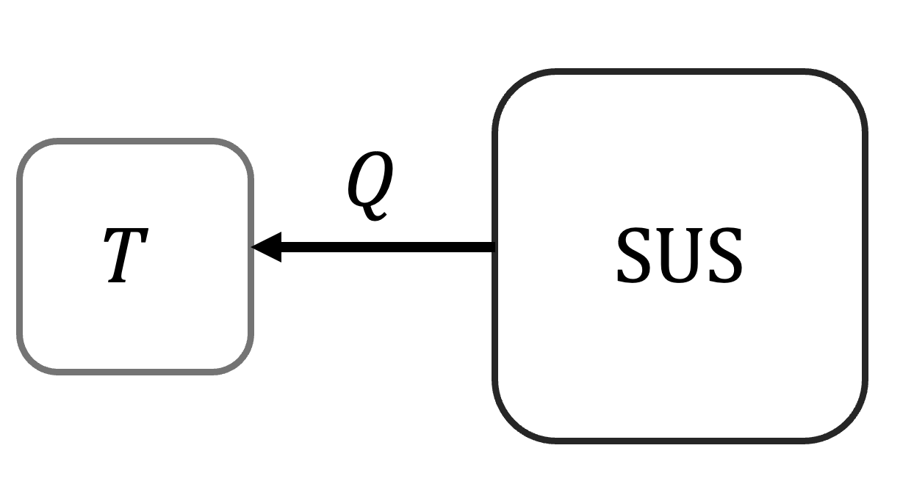
Building to nonequilibrium thermodynamics
Notes:
Possible states described by Boltzmann distribution at equilibrium (canonical ensemble)
- For now, a very simple Ising model with a heat reservoir and no ext mag field

Slide 3
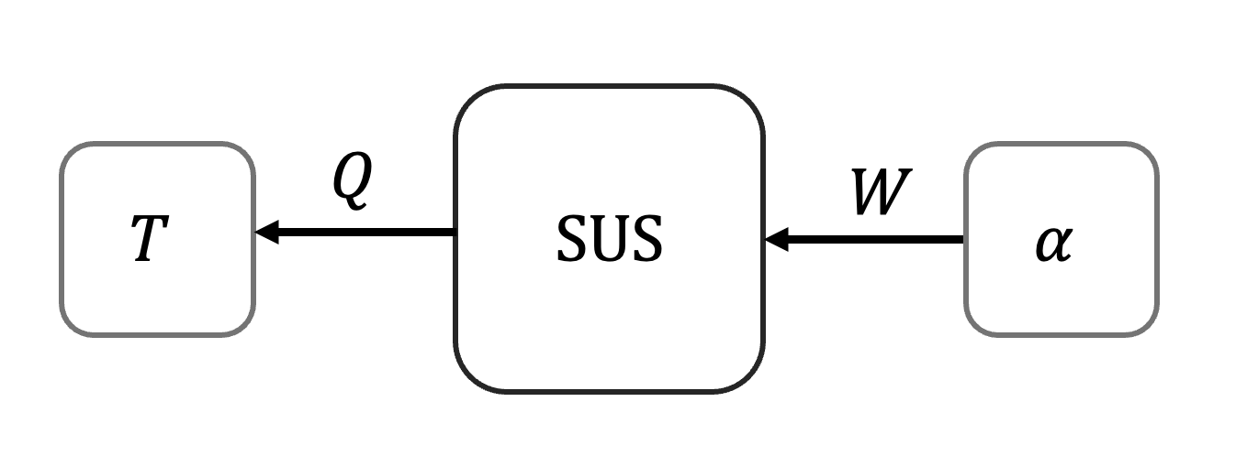
Building to nonequilibrium thermodynamics
Notes:
Introduce a parameter alpha by which we can do work (for our Ising model, can change strength of external magnetic field)
- Work reservoir causes no change in entropy
Each value of alpha will have a different steady state associated w it (still described by Boltzmann dist.)
Each ESS also corresponds very easily with an energy (because of B dist.)
Changing alpha:
Quasistatically = sys in a ss the whole time
Faster than that = sys is not in ss in the middle, but if we stop changing alpha at the end, sys will equilibrate with time to the new ss

Slide 4
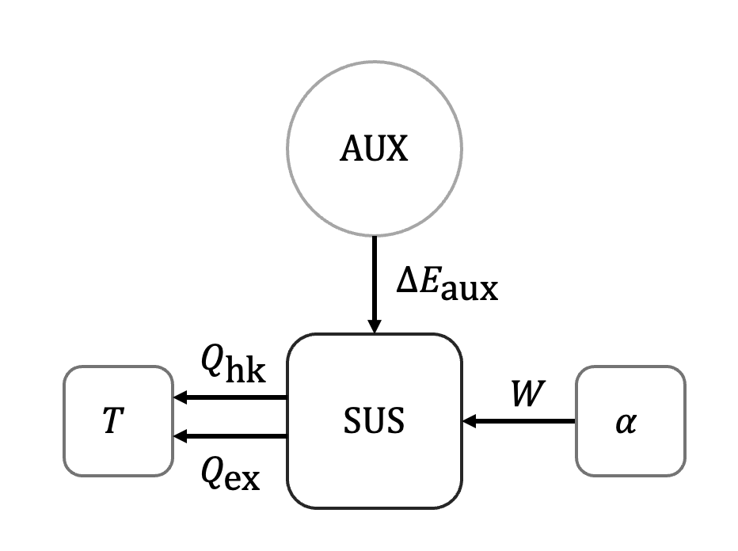
Building to nonequilibrium thermodynamics
Notes:
Now we add something else: ex. a second heat reservoir to our ising model
This thing changes the energy of the system in some way (Eaux)
When alpha is unchanging, W=0, dist. constant, but heat still flows between AUX and T reservoirs
this is NESS (not B dist, and dist =/= E in a well-defined way)
This is if we give the system time to equ. at alpha
Can also continuously change alpha -> sys doesn’t have time to relax into SS, constantly driven
(We also split total heat into two components)

Slide 5
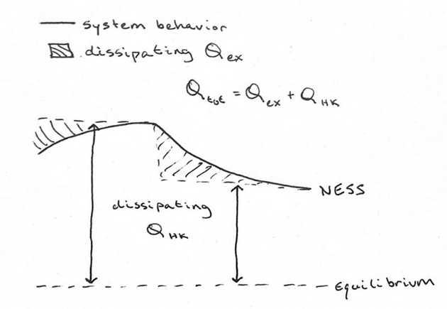
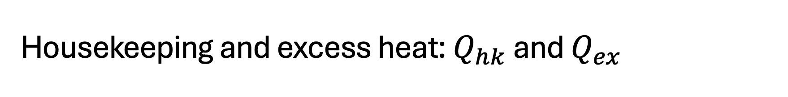
Housekeeping and excess heat: $Q_{hk}$ and $Q_{ex}$
Notes:
Excess heat and housekeeping heat
When SS = ESS, Qhk = 0 and Qtot = Qex
So we can think of Qex like we think about Qtot
important for comparison: adaptive energetics
How does it respond to stimulus in a NESS?

Slide 6
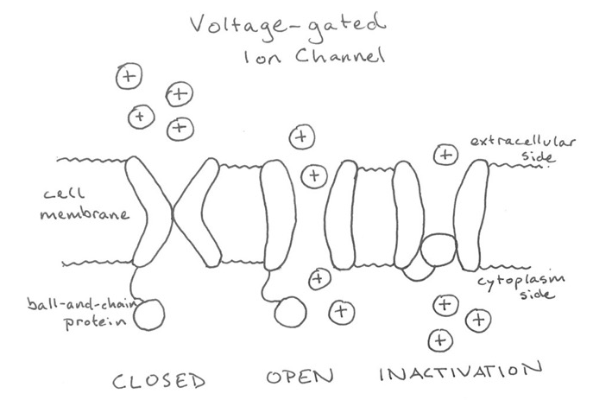
Notes:
Ion channels are pores along axons and synapses, moderate the depolarization of the cell membrane and allow propagation of electrical signals
Can be in one of three basic states: open, closed, inactivation (w this funky lil protein plug)
State depends on the charge gradient = transmembrane voltage
Modeled as dynamical systems since 1950s (ion channel structure discovered in 1970s)
Total current across the membrane is a function of voltage

Slide 7
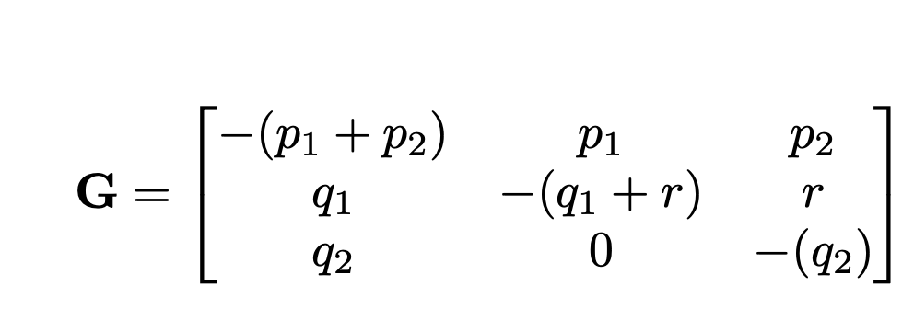
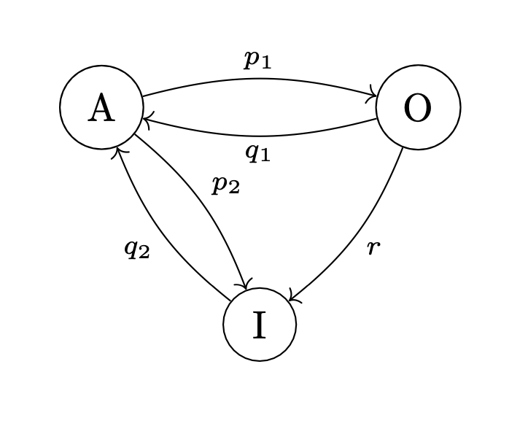
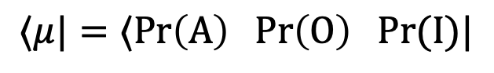
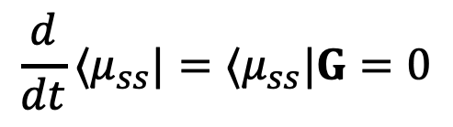
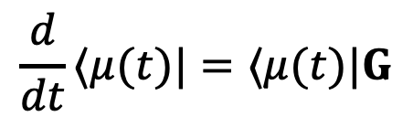
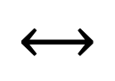
Markov chain
Transition rate matrix
$$⟷$$
$$⟨μ|=⟨\text{Pr}\left(\text{A}\right) \text{Pr}\left(\text{O}\right) \text{Pr}(\text{I})|$$
$$\frac{d}{dt}⟨μ(t)|=⟨μ(t)|G$$
$$\frac{d}{dt}⟨μ_{ss}|=⟨μ_{ss}|G=0$$
Steady state:
Notes:
here’s a model of the three states, called a Markov chain
These arrows are the rate/probability at which a channel changes between these states
Note one-way transition from open to inactivation
Arrange the rates into this matrix (G_{row i, column j} is rate from state i to j: A O I)
State dist is a row vector because convention? Makes the matrix nice
About brakets: stochastic thermos used for some quantum systems, notation makes crossover easier
Equation for evolution of state dist
Using a master equation approach rather than Hamiltonian
Steady state is when d/dt mu = 0, nullspace of G matrix

Slide 8
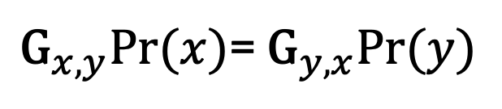
Detailed balance
${\text{G}}_{x,y}Pr⁡(x)$= ${\text{G}}_{y,x}Pr⁡(y)$
irreversible transition ⇒ violation
Detailed balance maintained ⇒ equilibrium steady states
Detailed balance violated ⇒ nonequilibrium steady states (probably)
Notes:
Detailed balance has implications for steady state behavior (E vs NE)
when violated, always a cycle, need nonzero Qhk to keep pushing the cycle
In bio systems, we expect violation because why would it be ESS

Slide 9
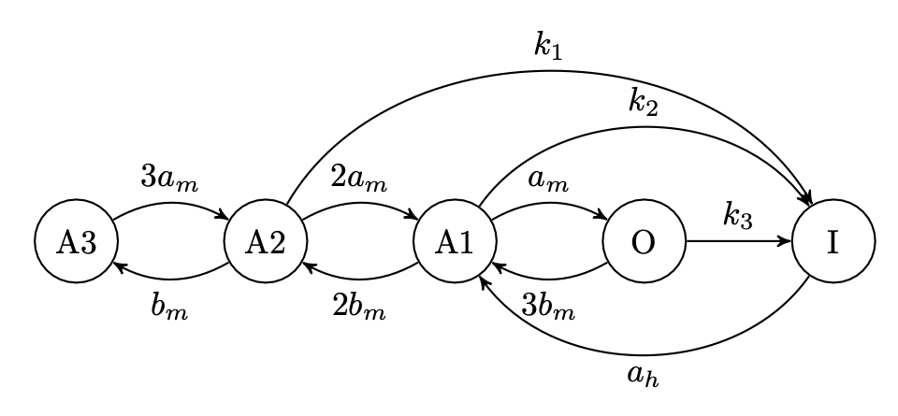
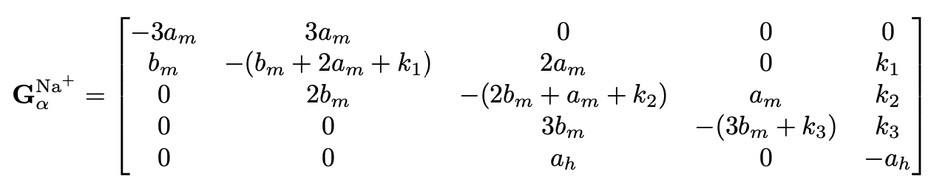
Sodium channel example
Notes:
Notice detailed balance violation in k1 and k3 transitions to inactivation
Transition rates a_m, b_m, and a_h a re functions of transmembrane voltage
Transition rates are calibrated to match steady state behavior with a constant voltage

Slide 10
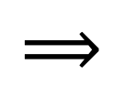
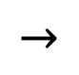
Gaps in existing modeling methods
poor understanding of NE thermos
multiple models
varied size and structure
steady state calibration
vs repeated driving behavior
forced detailed balance
biologically unrealistic
need for modeling with repeated driving, consideration of detailed nonequilibrium thermodynamic behavior
$$⟹$$
Medical application:
drug effect, disease modeling
Why does it matter?
$$→$$
Notes:
Multiple models: how do we distinguish?
Difference in number of states, allowed transitions
Calibrated to SS behavior
(Differ in transient behavior)
Bio systems that experience rapid and repeated driving
Forced detailed balance: not always realistic for small bio systems
Why do we care:
Used for modeling theoretical drug effects (channel blockers or openers), diseases that affect channel behavior
Models that better match realistic behavior in NE env. will give better predictions for those env.
(potential behaviors that are characteristic of model rather than the underlying physical system, don’t want to based predictions on funky artifacts)

Slide 11
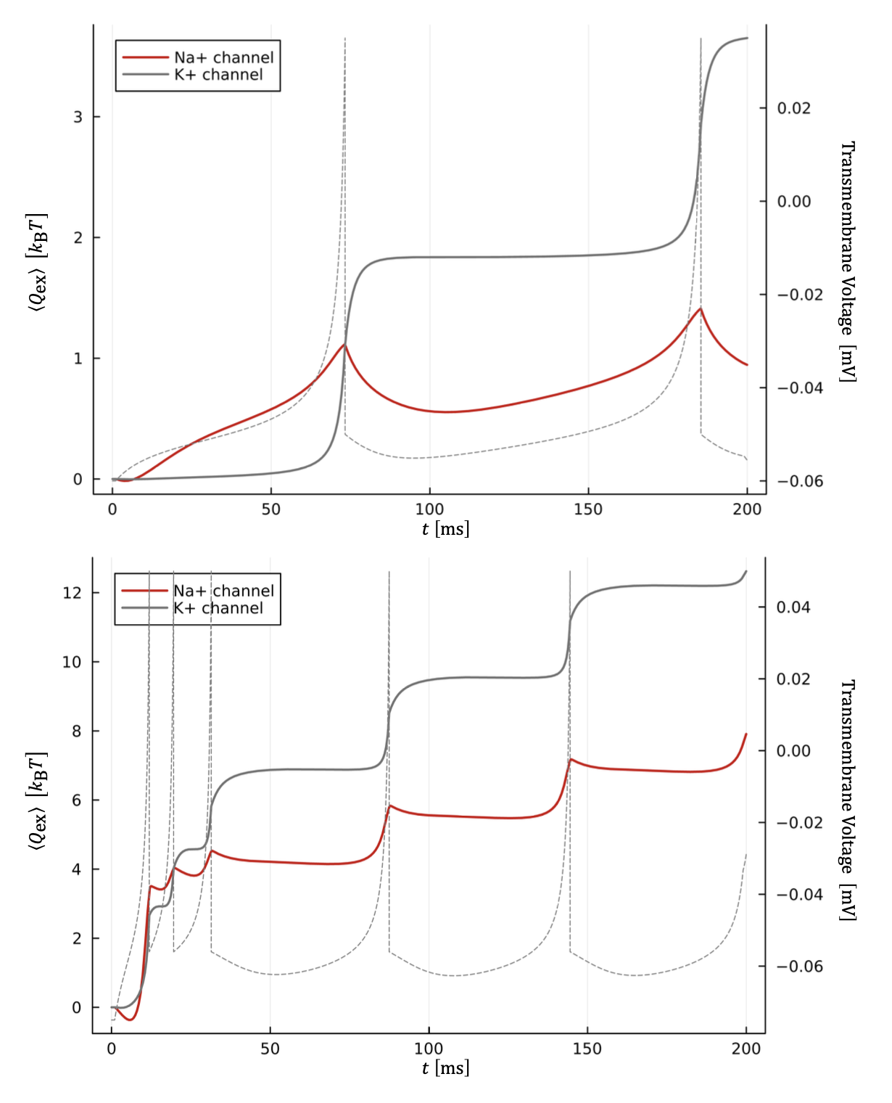
My work so far
Iterated Markov models of ion channels
Biologically realistic driving parameters
Calculated nonequilibrium thermo quantities to compare adaptive energetic behavior
Calculated transient current
Potential for experimental comparison
[V]
[V]

Slide 12
Next steps
Implement and compare more Na+ and K+ models
Test different scales of repeated driving
Explore additional thermodynamic quantities
EPR, H[X]
Connect with experimental lab to compare transient current
How do thermodynamic profiles differ between similarly performing ion channel models?
What nonequilibrium thermodynamic quantities are useful for evaluating and comparing ion channel models?
How do transient currents differ between similarly performing models, and how do they compare to experimentally observable values?

Slide 13
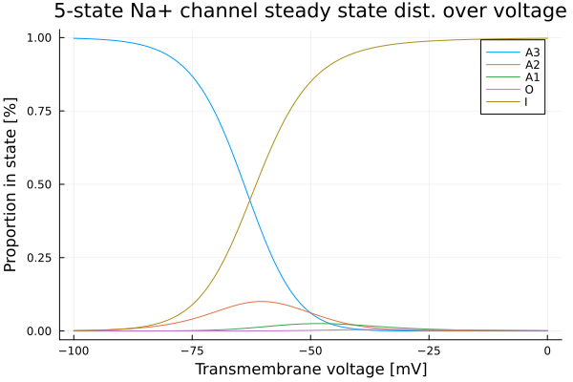
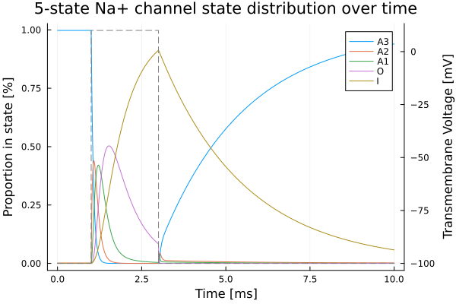
Notes:
Look they change
In these places of constant voltage, they settle into a “steady state”
Steady state is mostly bimodal, gets stuck in inactivation for high voltages
Also visible in live distribution, go through closed states to open state and then to inactivation state, only relax back to closed when protocol decreases

Slide 14
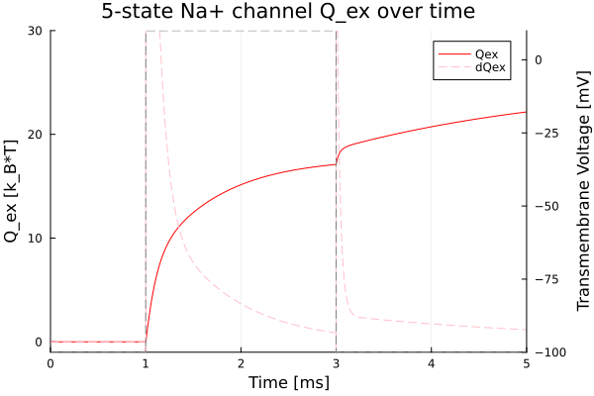
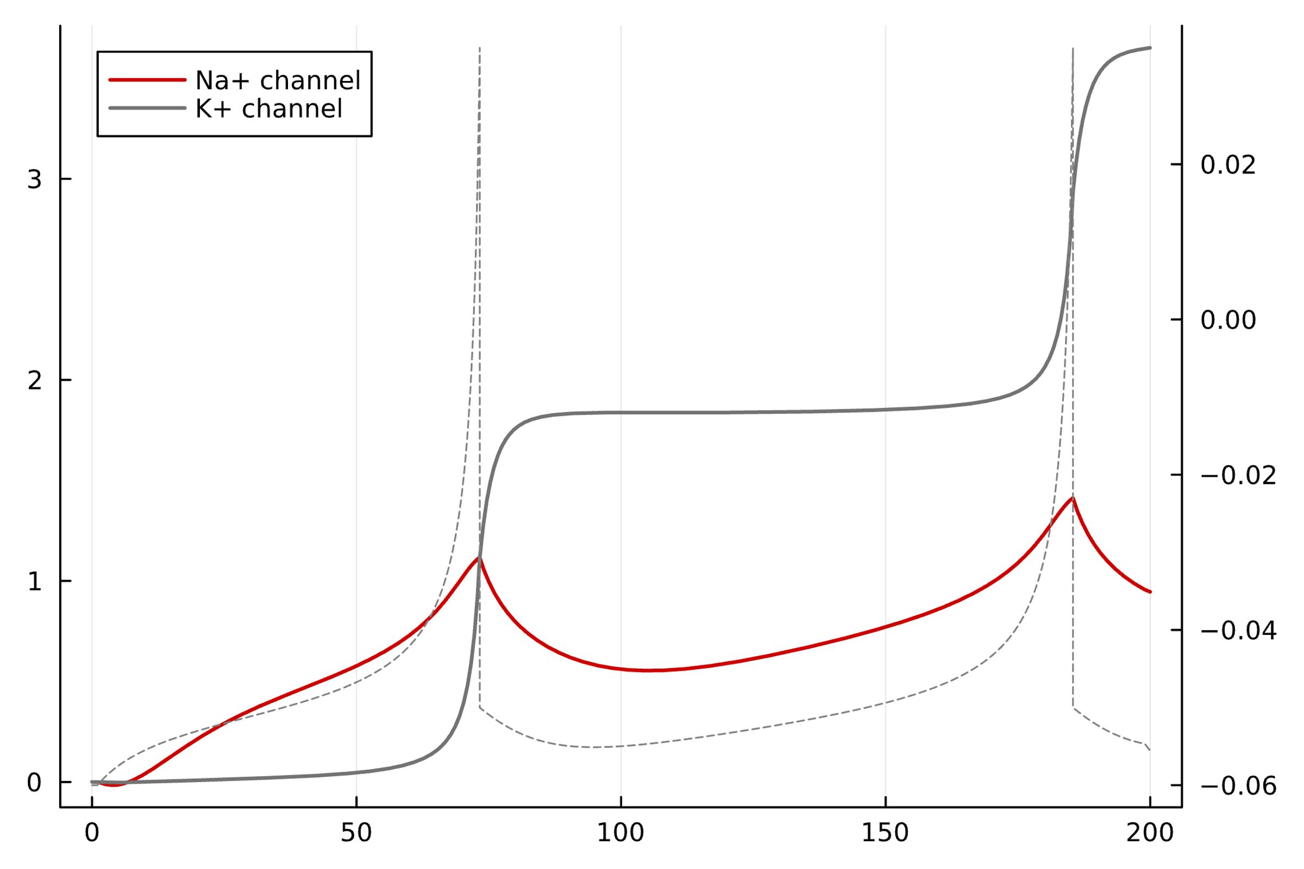
Excess heat calculations
Na+ and K+ channels Q_ex with spike protocol
Transmembrane voltage [V]
Time [ms]
Notes:
here’s the heat from the square voltage from before (as it accumulates) dissipating
Now here’s the heat from a realistic “action potential” voltage pattern that occurs in neurons
Now look at the different type of ion channel, the shape is different
Different speed of response, different overall dissipation
*note that the timescale on the spike protocol is much slower, hence the lower dissipation
The potassium channel does not violate detailed balance, as opposed to the sodium channel, but can be compared with this metric of Q_ex
Also other metrics of entropy production and irreversibility (Shannon information entropy), can be calculated and compared, correspond to dQex and whatnot

Slide 15
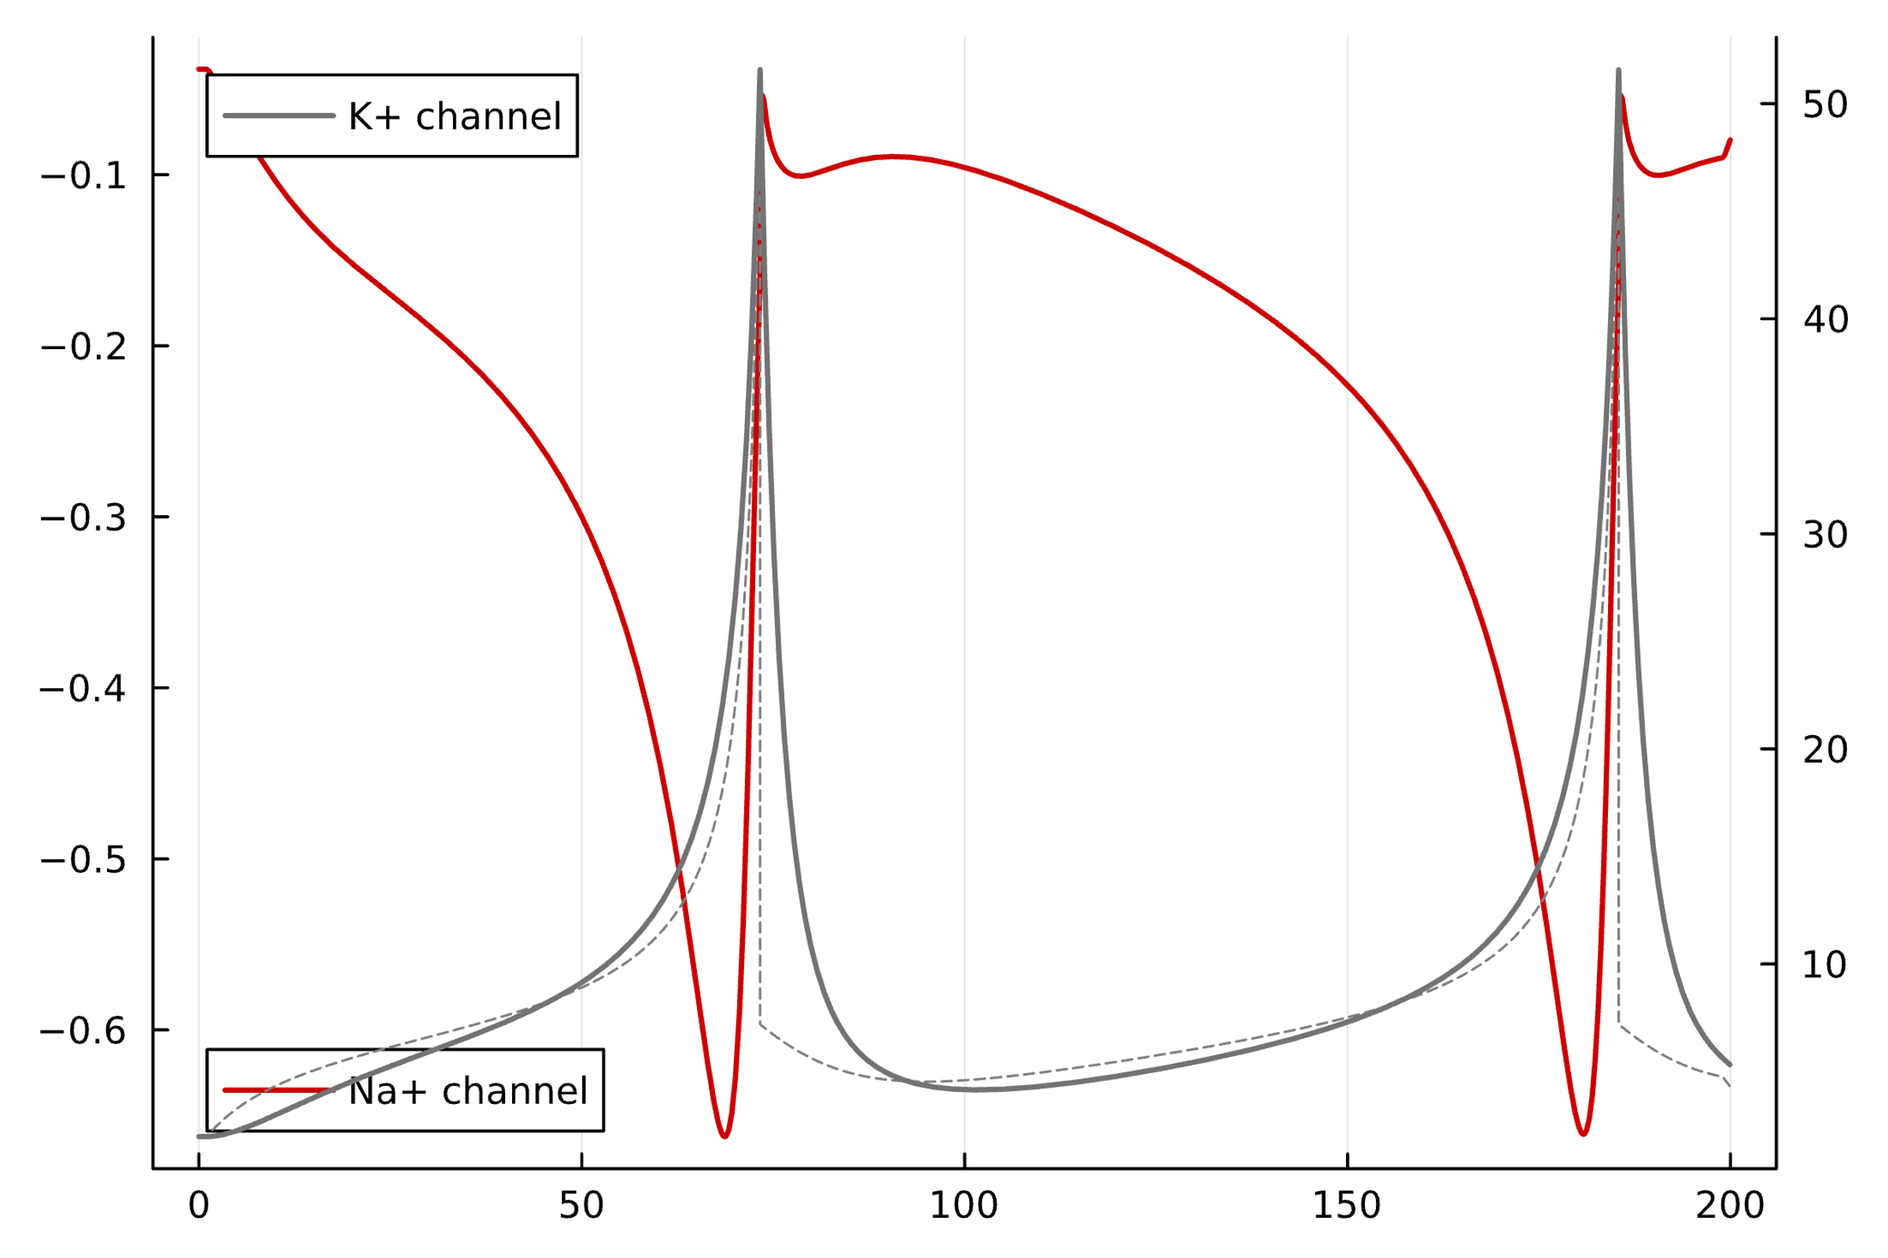
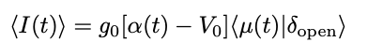
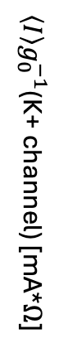
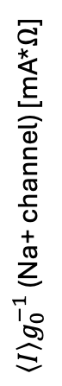
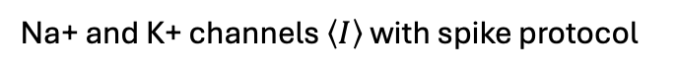
Transmembrane current
Na+ and K+ channels $\left\langle I\right\rangle$ with spike protocol
$\left\langle I\right\rangle g_{0}^{−1}$(K+ channel) [mA*$Ω$]
$\left\langle I\right\rangle g_{0}^{−1}$ (Na+ channel) [mA*$Ω$]
rest voltage
Time [ms]
conductance
% in open state
Notes:
Remember only particular states of the ion channel (usually one) are open
It only conducts current when it is in this open state
Current through patch is directly proportional to amount in the open state
This is useful:
Observable experimentally (not usually run with this protocol, tho)
Detailed transient behavior (may be worth it to match with physical system)

Slide 16
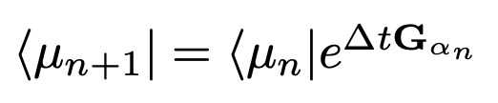
Markov chain
Transition rate matrix
$$⟷$$
prev. state dist.
state distribution
transition matrix
Notes:
here’s a model of the three states, called a Markov chain
These arrows are the rate/probability at which a channel changes between these states
Arrange the rates into this matrix (G_{row i, column j} is rate from state i to j: A O I)
State vector is a row vector because convention?
Transition rate matrix to transition matrix by *dt and exponentiating
Now we just iteratively multiply the state vector by this matrix
Remember, it is voltage dependent, so we can vary the voltage and see how it changes

Slide 17
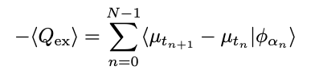
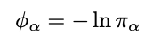
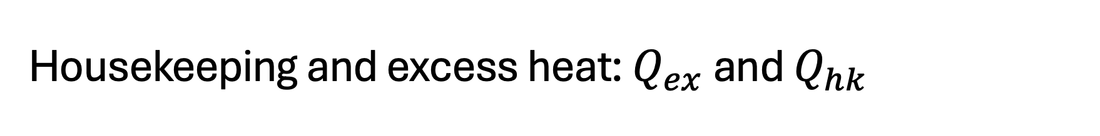
Housekeeping and excess heat: $Q_{ex}$ and $Q_{hk}$
Steady state surprisal
Notes:
Excess heat and housekeeping heat
Surprisal= Shannon self-information, how much entropy in an individual event/distribution
important for comparison: adaptive energetics
How does it respond to stimulus in a NESS?
Can compare otherwise disparate models: if it violates detailed balance, normal heat diverges and is not useful

Slide 18
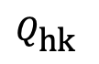
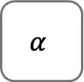
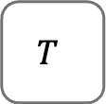
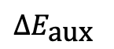
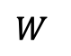
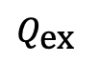
AUX
$${∆E}_{\text{aux}}$$
$$Q_{\text{hk}}$$
SUS
$$T$$
$$W$$
$$α$$
$$Q_{\text{ex}}$$

